Slide 1

SMART INDIA HACKTHON 2020
Ministry Category : Airports Authority of India
Problem statement : A visual Dashboard based on data analytics for percentage utilization of Airport facilities and utilities using IoT.
Problem Code : AK13
Team Name :CSEGECCD2K21
Team Leaders Name : U. Lekha Sree
College Code :1-4266244881

Slide 2
Solution/Approach
Provision of this prototype are “admin” authority” .
and “local-
By scanning the passport , the admin verifies the passport details.
Whenever the users want to use any services they should scan the passport.
After scanning , the accessed services details will be stored in the database.
The data in a particular airport can be accessed by the local- authority.
The data from different airports are integrated into a database.
The integrated database can be accessed by the admin using different visualization techniques - Bar graphs , pie charts, histograms.

Slide 3
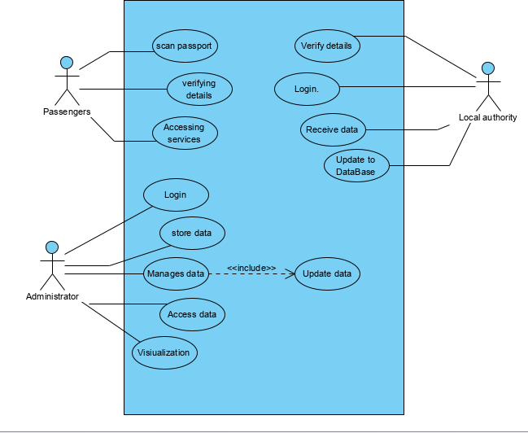
USECASE DIAGRAM
Passenger:
Scans the passport before using the services.
Administrator:
Visualizes the integrated data from different airports.
Local-authority:
Access the data regarding services of particular airport.

Slide 4
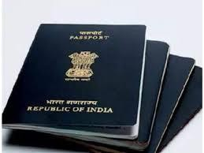








Scanning
Accessing
- services
Passengers
Barcode Scanner
Services
Passport
Details stored in DB
Pictorial Representation
of data
Integrating Data
Databases
Visualizing data
Integrated-Database
Access data
Local-Authorities

Slide 5
Technology Stack
Python Programming
Bootstrap/HTML/PHP
Arduino C
Google Firebase Database
Dependencies:
Life time of Hardware Assembly.
A stable Internet connection is required.

